Slide 1

GIET UNIVERSITY
LEARNATHON 4.0
TEAM_ID- (MB-6)-06
TEAM-LEARNATICS
MEMBERS-NIHAR RANJAN MISHRA(24MCA070)
-ASUTOSH CHOUDHURY(24MCA072)
-MANJIL PATEL(24CSEAIML106)
Notes:
• Bienvenidos a nuestra presentación sobre tecnología de agricultura inteligente en la Universidad GIET. • Pueden ver en esta diapositiva el logotipo de nuestra universidad, junto con tres imágenes que muestran varias tecnologías de agricultura inteligente. • Estas tecnologías están revolucionando la forma en que abordamos la agricultura, haciéndola más eficiente, sostenible y productiva. • Profundizaré en los detalles de estas innovaciones en las próximas diapositivas. • Por ahora, tomemos un momento para apreciar el emocionante futuro de la agricultura que la Universidad GIET está ayudando a dar forma.

Slide 2
INTRODUCTION-
The Smart Crop & Fertilizer Advisory System is an innovative solution designed to empower small farmers. By leveraging cutting-edge technology, it provides precise, data-driven recommendations for optimal crop selection and fertilizer application, ensuring sustainable growth and increased yield.
This advanced system integrates various data points, including soil type, local climate conditions, historical weather patterns, and specific crop requirements. By analyzing these critical factors, it generates tailored advice that helps farmers make informed decisions, minimizing resource waste and maximizing agricultural output.
Real-time Data Analysis: Continuously processes environmental and soil data to offer up-to-the-minute insights.
Personalized Recommendations: Delivers customized advice for crop types and fertilizer dosages specific to each farm's unique profile.
User-Friendly Interface: Designed for easy access and understanding, enabling farmers of all technical levels to utilize its full potential.
Sustainability Focus: Promotes eco-friendly farming practices by optimizing resource use and reducing environmental impact.

Slide 3

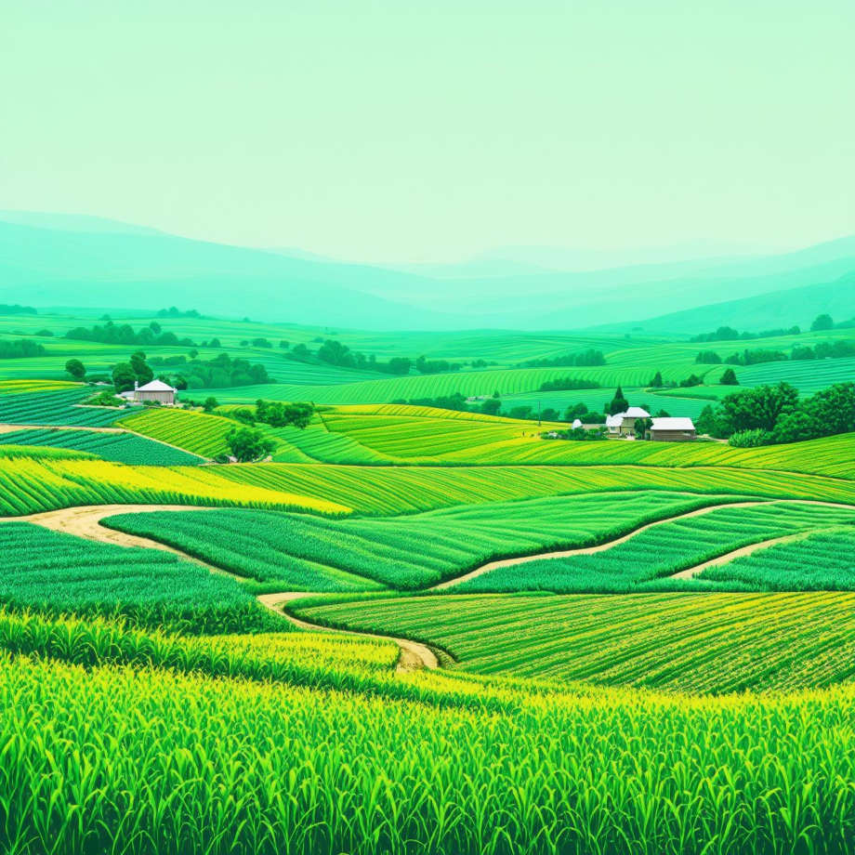
Smart Crop & Fertilizer Advisory System
Empowering small farm holders with data-driven insights for optimal crop selection and sustainable agriculture.

Slide 4


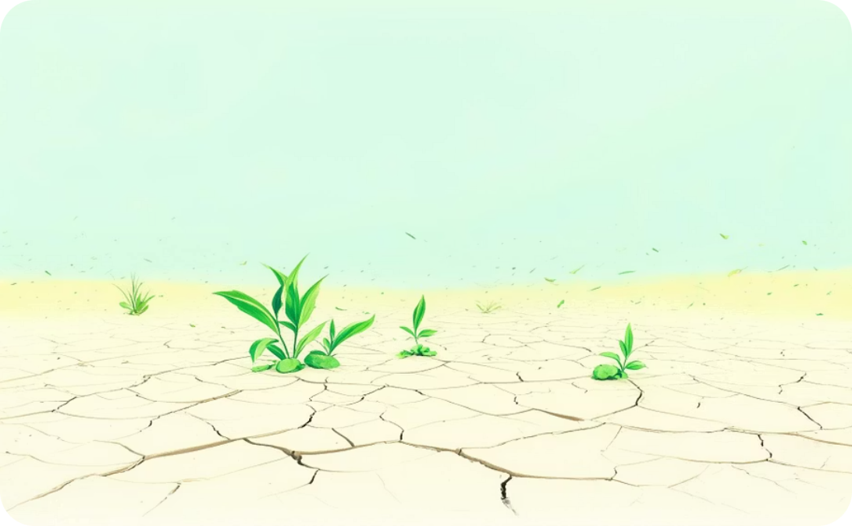
The Challenge for Small Farmers
Small farm holders often face challenges in crop selection, leading to suboptimal yields and wasted resources. Traditional methods can be unreliable.
Without precise data, crop choices often don't match soil and climate, leading to lower productivity and suboptimal yields.
Inefficient use of water, fertilizers, and seeds results in significant resource waste due to a lack of informed decision-making.
Over-fertilization and improper crop rotation can degrade soil health and local ecosystems, leading to a negative environmental impact.

Slide 5


Introducing the Smart Advisory System
Our system leverages sensor technology and data analytics to provide precise, actionable recommendations for crop cultivation and fertilizer application.
Sensor-Assisted Data Collection
Intelligent Data Analysis
Real-time sensors collect crucial data on soil macronutrient levels (N, P, K), accurate pH measurements, and environmental factors such as temperature, humidity, and rainfall.
Proprietary algorithms analyze the collected data, comparing it with ideal crop requirements and employing predictive modeling to forecast future conditions for optimal advice.

Slide 6

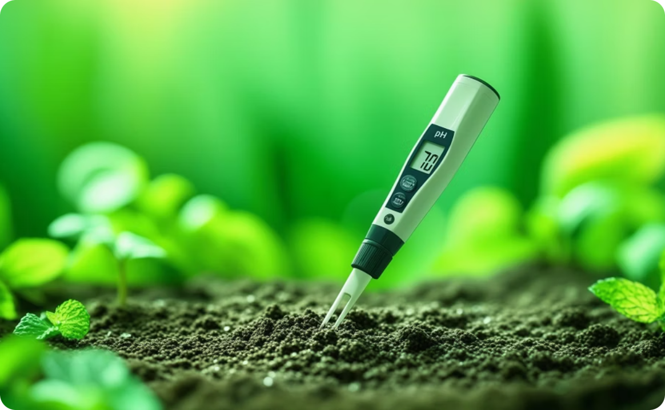
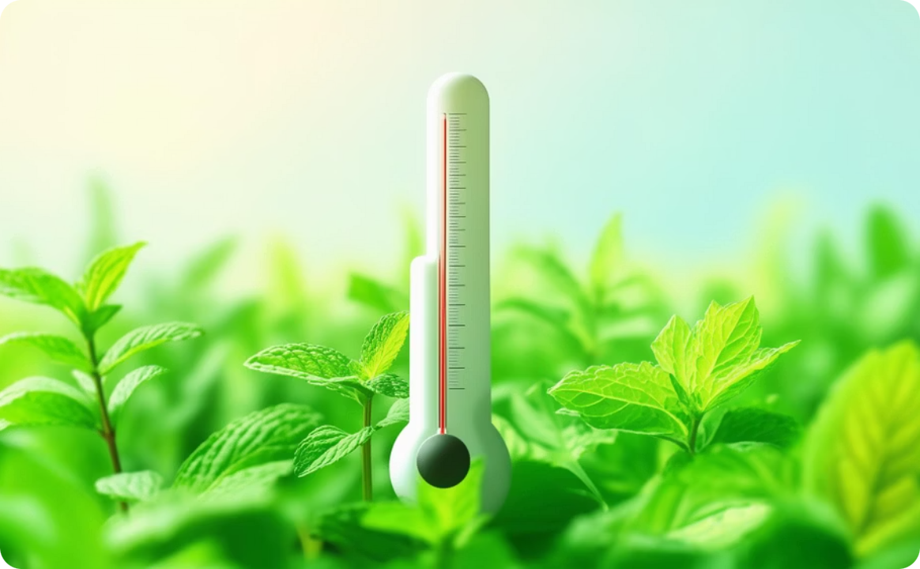


Key Parameters for Crop Recommendation
The system analyzes critical environmental and soil factors to ensure the most suitable crop is suggested for your farm.
Soil Macronutrients
pH Level
Temperature
Nitrogen (N), Phosphorus (P), and Potassium (K) levels are crucial for plant growth and yield.
Optimal soil pH ensures nutrient availability and uptake for specific crops.
Ideal temperature ranges are vital for seed germination and plant development.
Humidity
Rainfall
Atmospheric moisture affects plant transpiration and disease susceptibility.
Adequate water supply through rainfall or irrigation is essential for crop survival and yield.

Slide 7
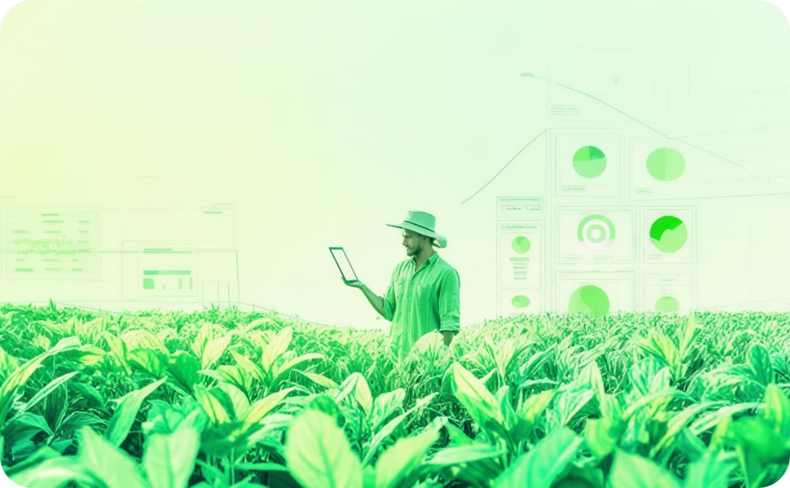


Intelligent Crop & Fertilizer Advisory
Based on the analyzed data, the system generates precise recommendations and actionable insights.
Optimal Crop Suggestion
Tailored Fertilizer Advisory
Yield Potential Insights
Identifies crops best suited to current soil and weather conditions.
Recommends specific fertilizer types and application rates to correct nutrient imbalances.
Provides estimates of potential yield based on optimal conditions and management.

Slide 8
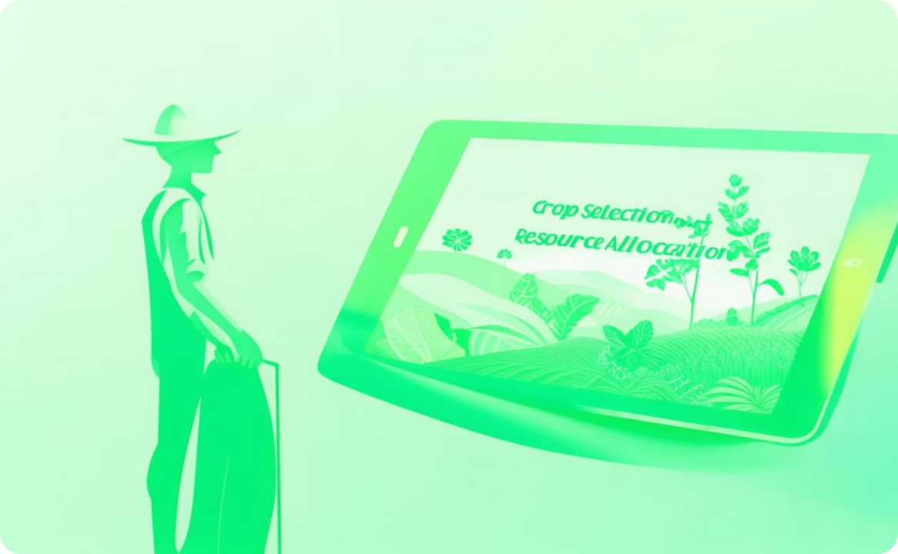
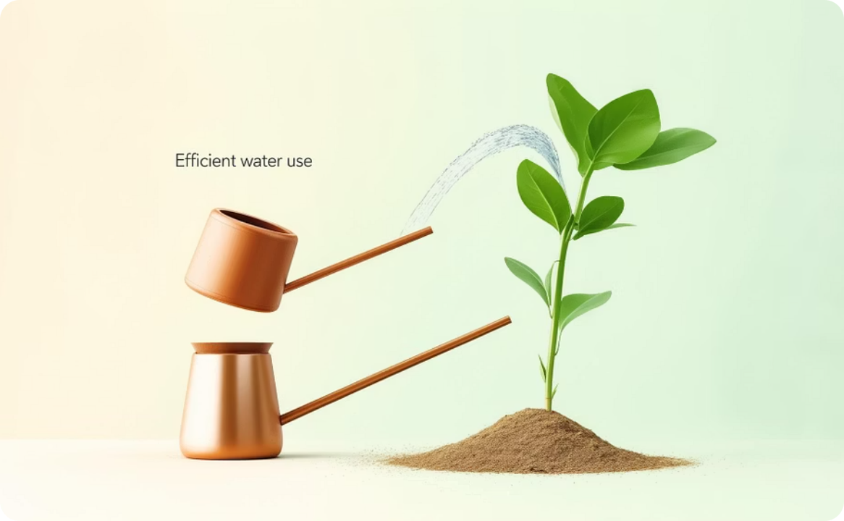


Expected Outcomes and Benefits
Implementing the Smart Advisory System leads to significant improvements for small farm holders.
Empowered Decision-Making
Optimized Resource Use
Improved Soil Fertility
Farmers gain scientific insights, moving beyond guesswork for crop selection and resource allocation.
Reduced waste of water, seeds, and fertilizers, leading to cost savings and environmental benefits.
Precise fertilizer recommendations prevent over-application and promote long-term soil health.
Increased Yield & Profitability
Selecting the right crop for the right conditions maximizes productivity and boosts income.

Slide 9

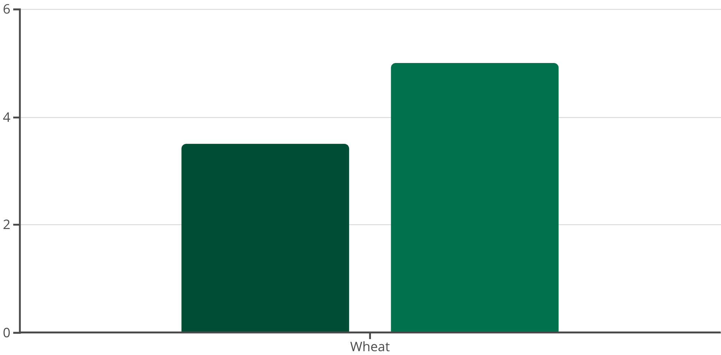
Example Impact: Increased Yield for Wheat Farmers
A case study demonstrates the potential for significant yield increases in wheat cultivation through data-driven recommendations.
Average Yield (Tons/Hectare)
Projected Yield with System...
By providing precise insights into optimal planting times, fertilizer needs, and soil adjustments, the system can help small farmers achieve a substantial increase in their wheat harvest, enhancing food security and economic stability.

Slide 10





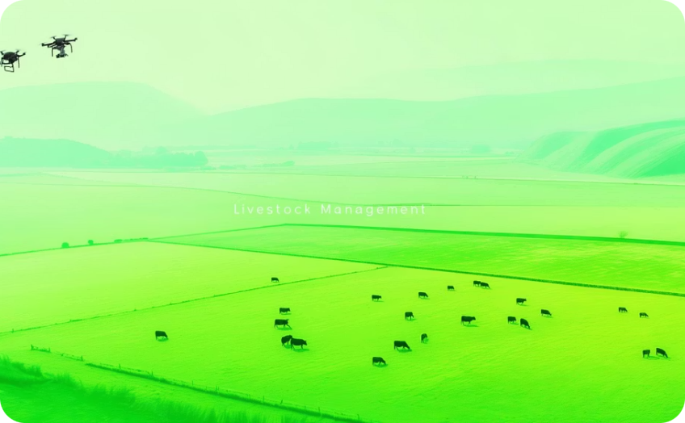


Conclusion & Next Steps
The Smart Crop & Fertilizer Advisory System represents a leap forward for small-scale agriculture, fostering sustainability and prosperity.
Data-Driven Decisions
Optimized Resource Use
Increased Yields & Profit
Sustainable Practices
Leverage scientific insights for optimal agricultural outcomes.
Efficiently manage water, seeds, and fertilizers to reduce waste and costs.
Maximize crop productivity and boost farm income through informed choices.
Encourage eco-friendly farming to promote long-term soil health.
Pest & Disease Forecast
Livestock Management
Mobile Accessibility
Research Partnerships
Future integration of predictive models for proactive farm protection.
Expand to include smart solutions for livestock health and management.
Develop an intuitive mobile application for on-the-go advisory access.
Collaborate with agricultural research institutions for continuous innovation.

Slide 11
THANK YOU
Let's cultivate a smarter, more sustainable future for agriculture, together.

